Slide 1
Basic introduction to R
Or: how I learned to stop worrying and love the code
Dr Erin I walsh | 1/2/2019

Slide 2
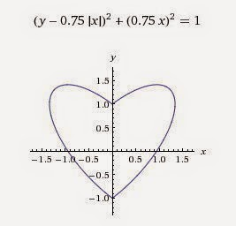
Learning R is an excellent idea.
Runs on all major operating systems
Intentionally built to encourage user flexibility
Extensive active, helpful user community
Anyone can contribute
Primary source code is curated by the R Core Group (but anyone can suggest changes)
Anyone can make packages to extend base functionality
Continually updated (though based on almost 50-year-old foundations)
No cost!
Image from: http://3.bp.blogspot.com/-os4wGSnoRxk/U-iIVxN-OjI/AAAAAAAAGH4/t0JTmnNyYLs/s1600/Heart,+mathematical+equation,+2D+1+-+0b.jpg

Slide 3

Free as in ‘freedom’ (but also as in ‘beer’)
GNU Public License since 1995
Four basic principles:
Freedom to run the program for any purpose
Freedom to study/adapt the source code
Freedom to redistribute
Freedom to improve
Pro/con: user responsibility (populist development trajectory)
Perfectly aligned with best practice in science!

Slide 4
R is a bit… unusual.
Not like anything you’d have used before (Hybrid vigour)
Reproducibility (know what you’re doing, show what you’re doing)
Lego-style build-it-yourself functionality (Package structure)
Exercises today intended to walk through the more unusual parts (especially coming from an epi or psych background): basics of functions, loops, packages, scripts and markdown.

Slide 5
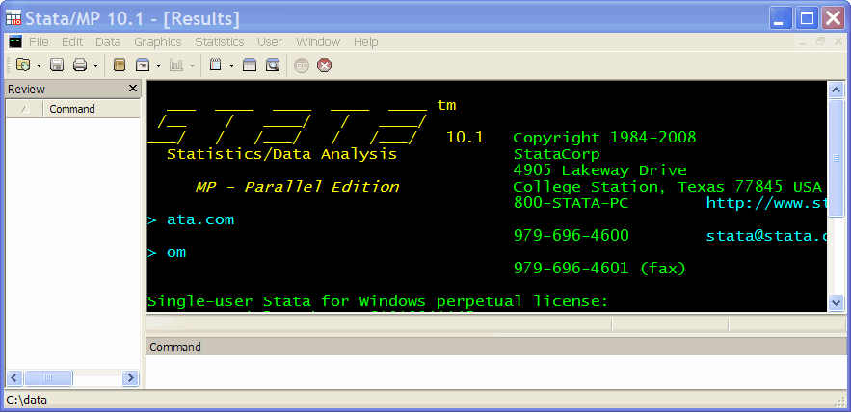
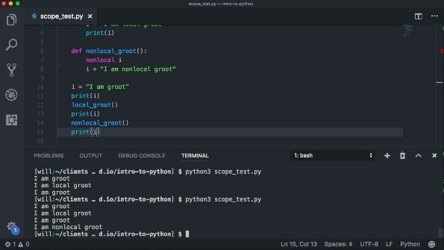
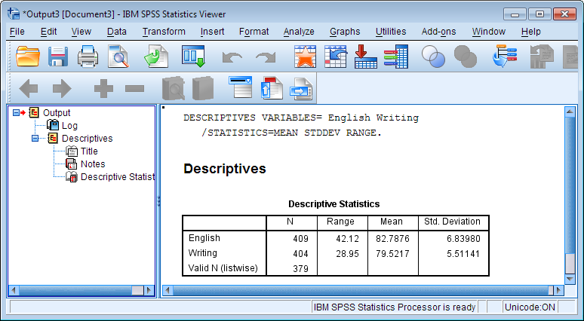
Statistics programs types (and user expectations)
Console/command line
command by command
interactive
e.g. SAS, STATA
Programming language
executable scripts
systematic
e.g. Python
GUI
No/limited programming
e.g. SPSS

Slide 6
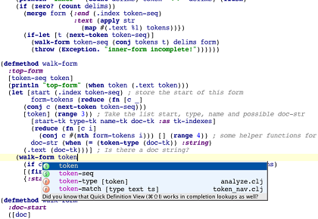

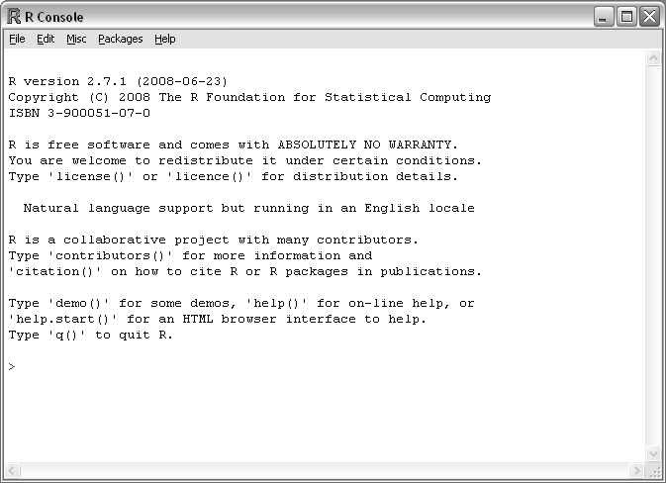
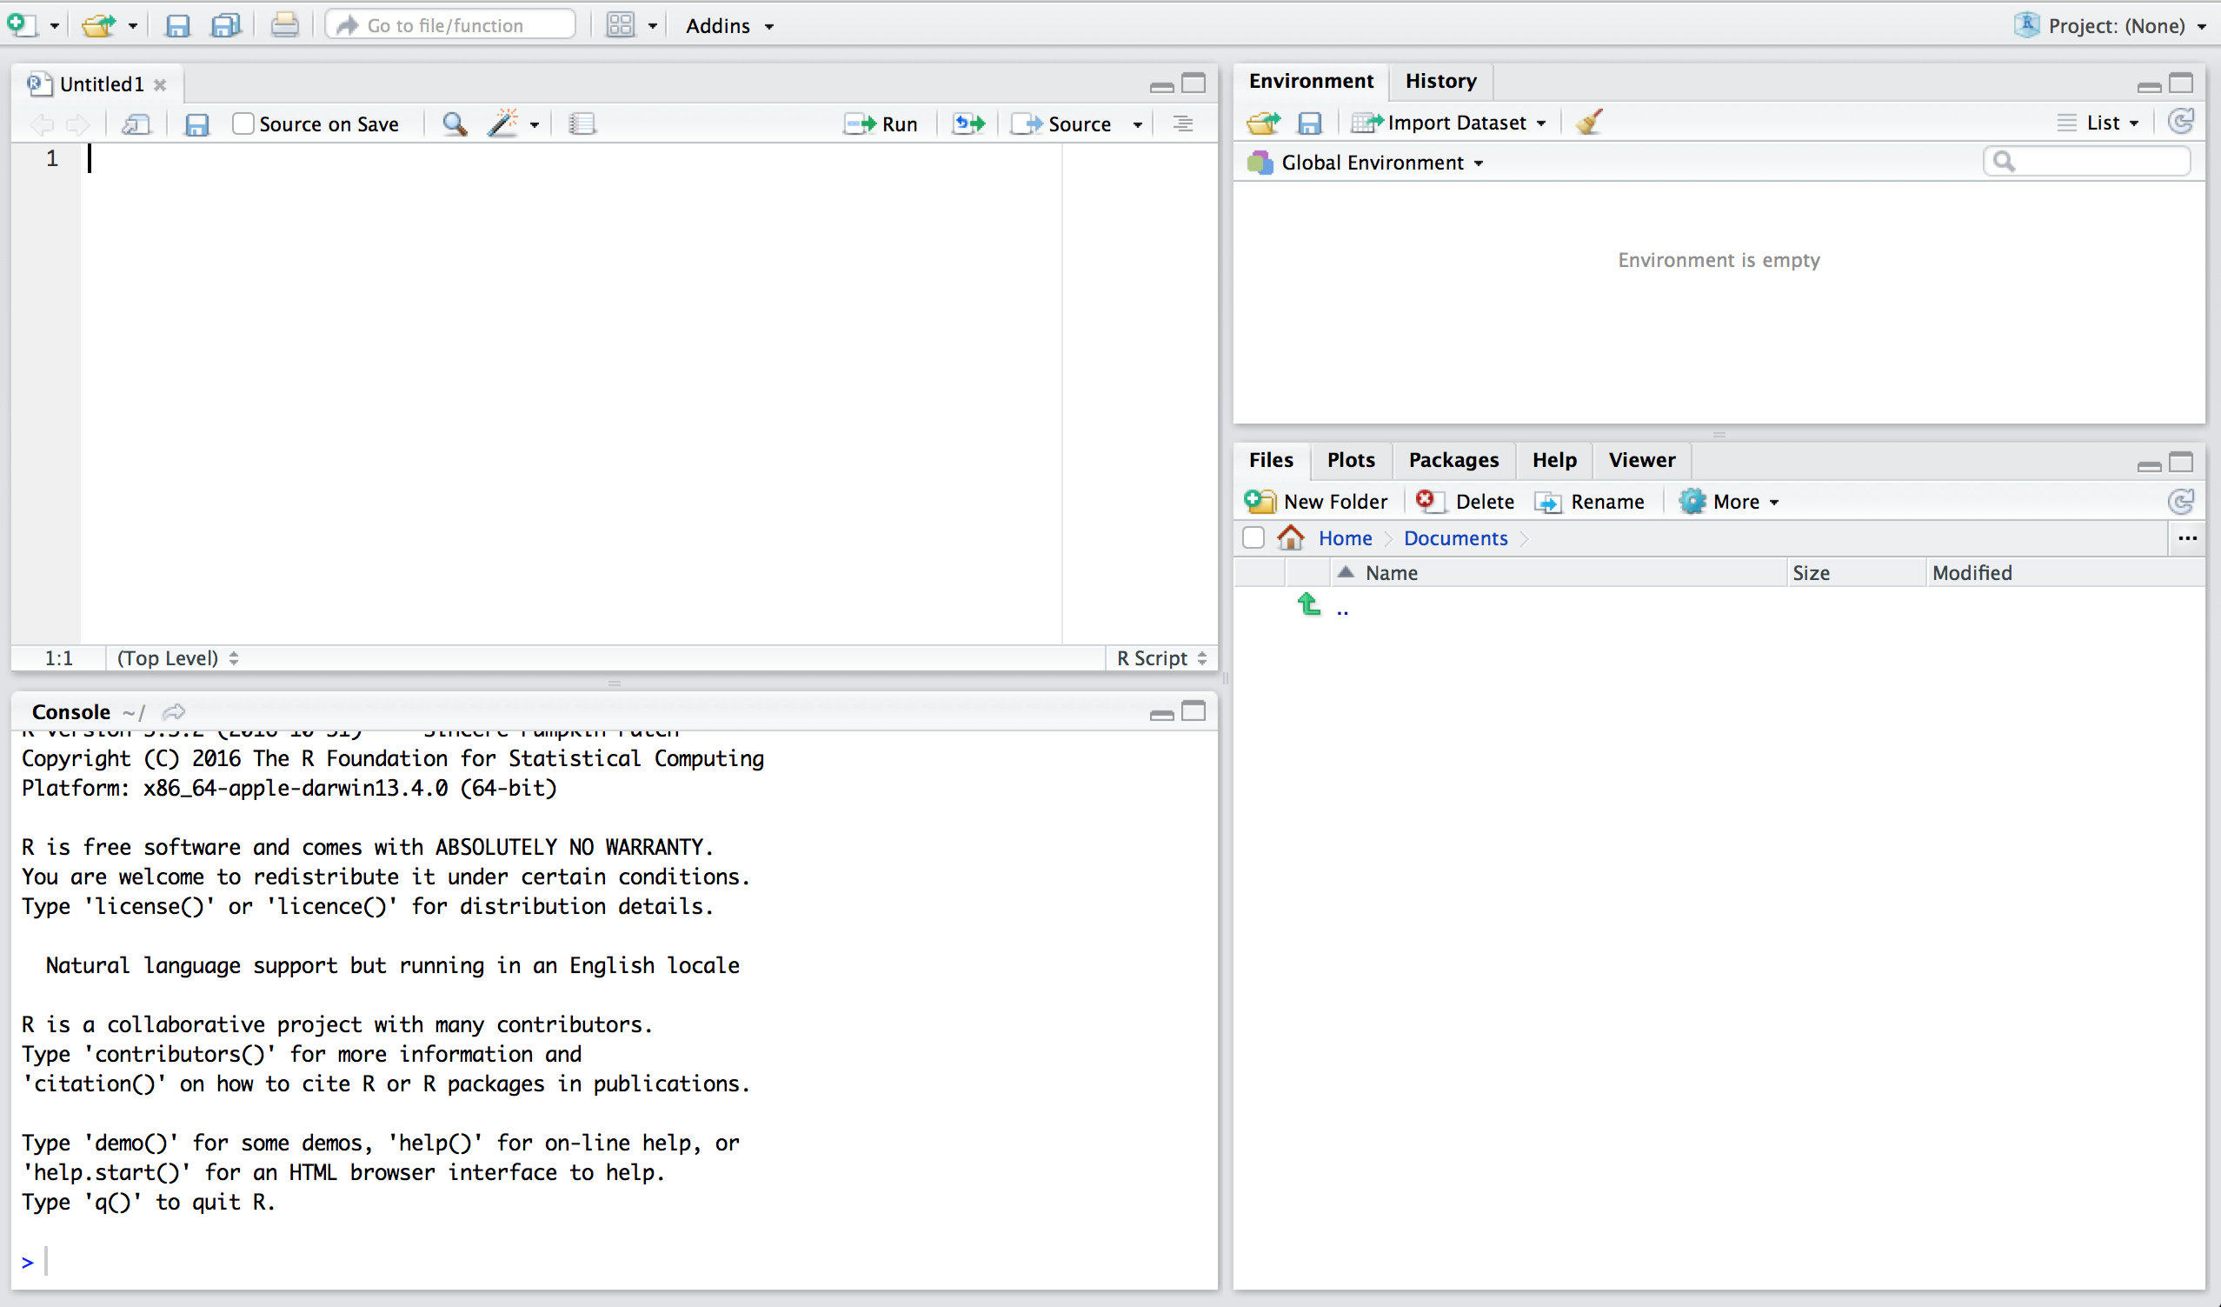
Hybrid vigour
Historical basis in programming language (S)
Developed 1976 in Bell Labs
Basis in Fortran, then C
In modern form 1998
R split off in 1991-1996
Command line functionality
GUI elements (Rstudio)

Slide 7
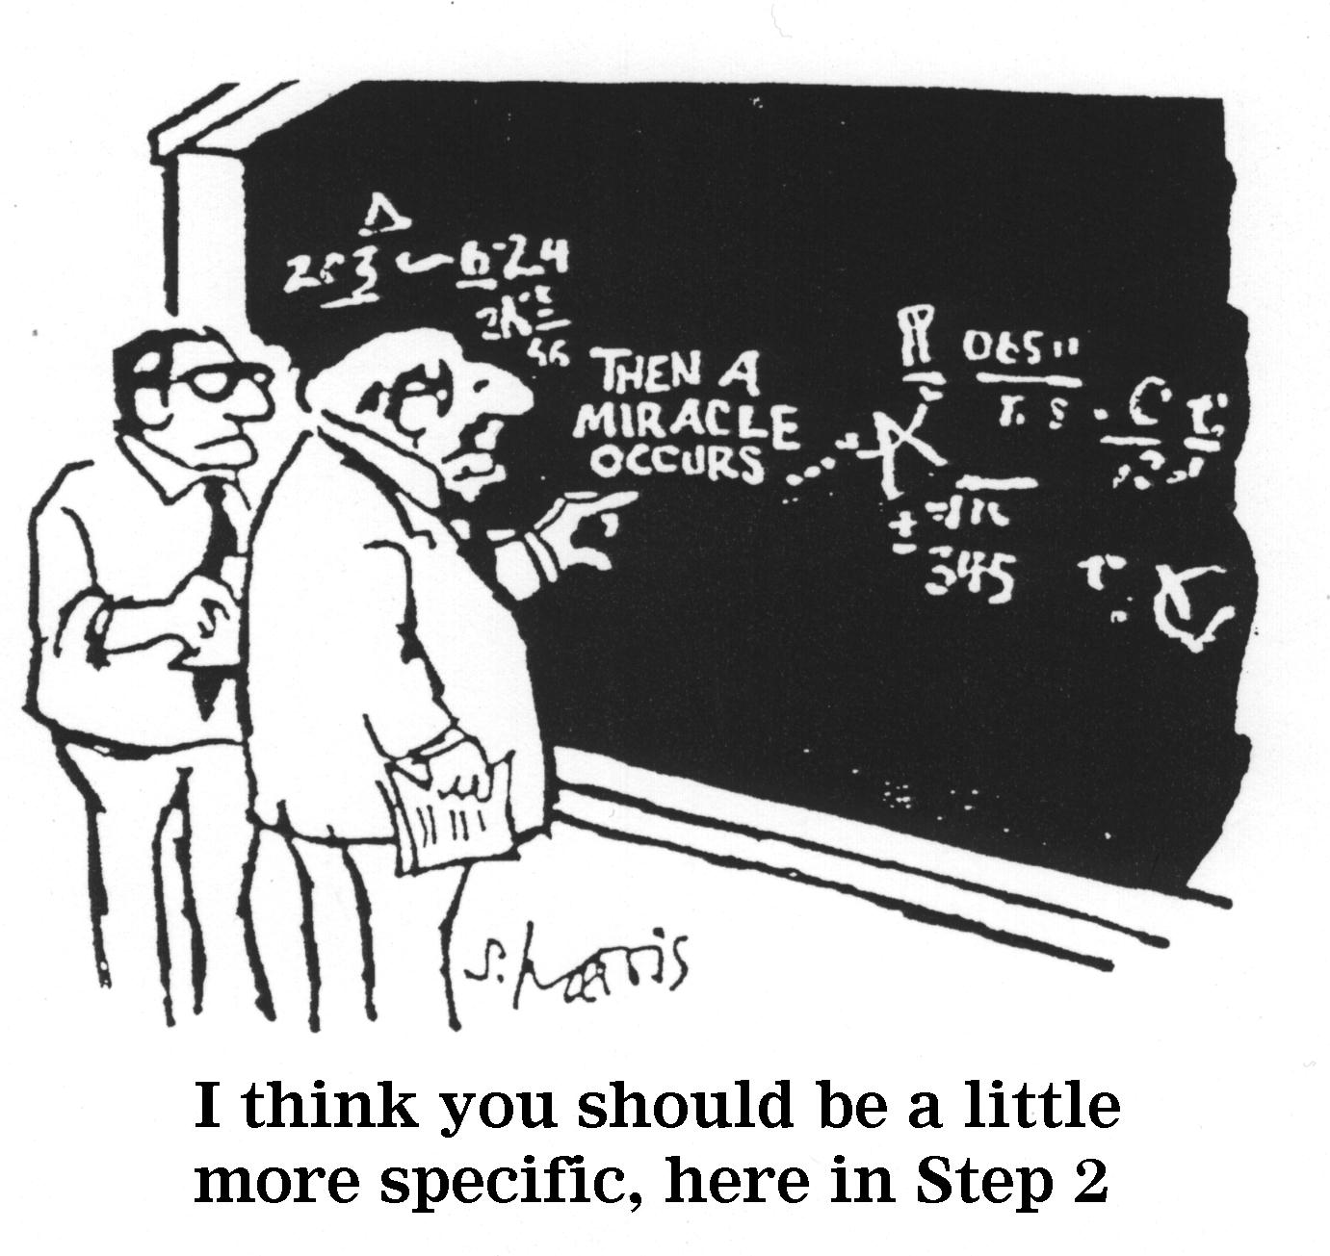
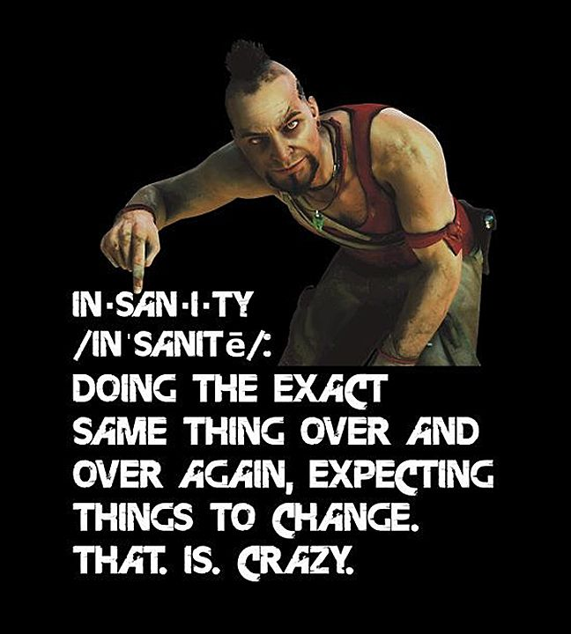
Reproducibility
The whole process of data -> analysis -> reporting can be reproducible.
This minimises human error and increases transparency.

Slide 8
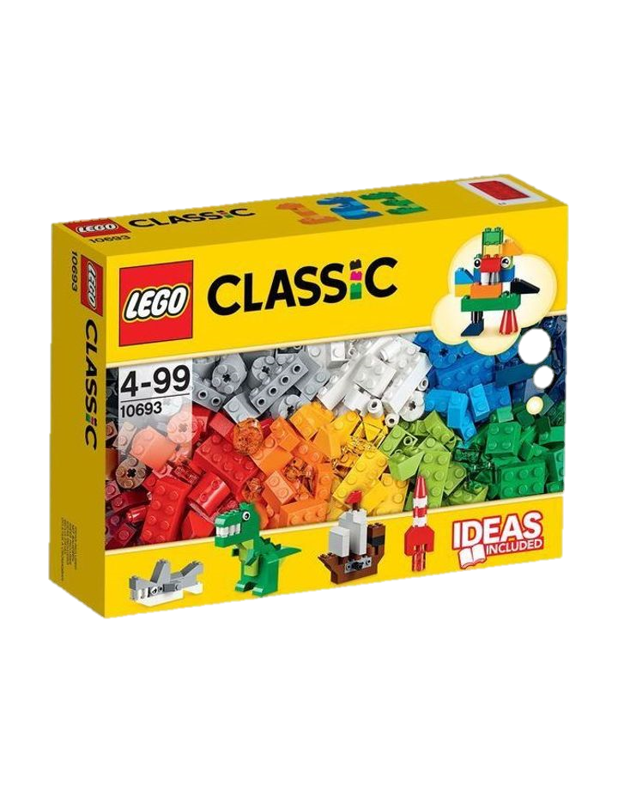
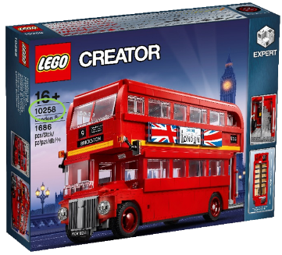
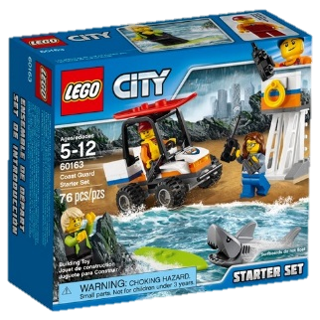
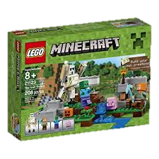


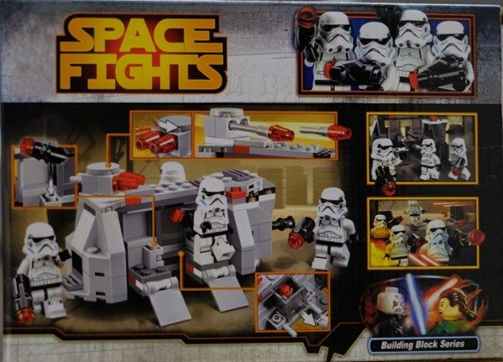
Package structure
Base R
Packages
CRAN (curated)
Non-curated:
Github
Personal hosting
Image from: https://legogradstudent.tumblr.com/

Slide 9
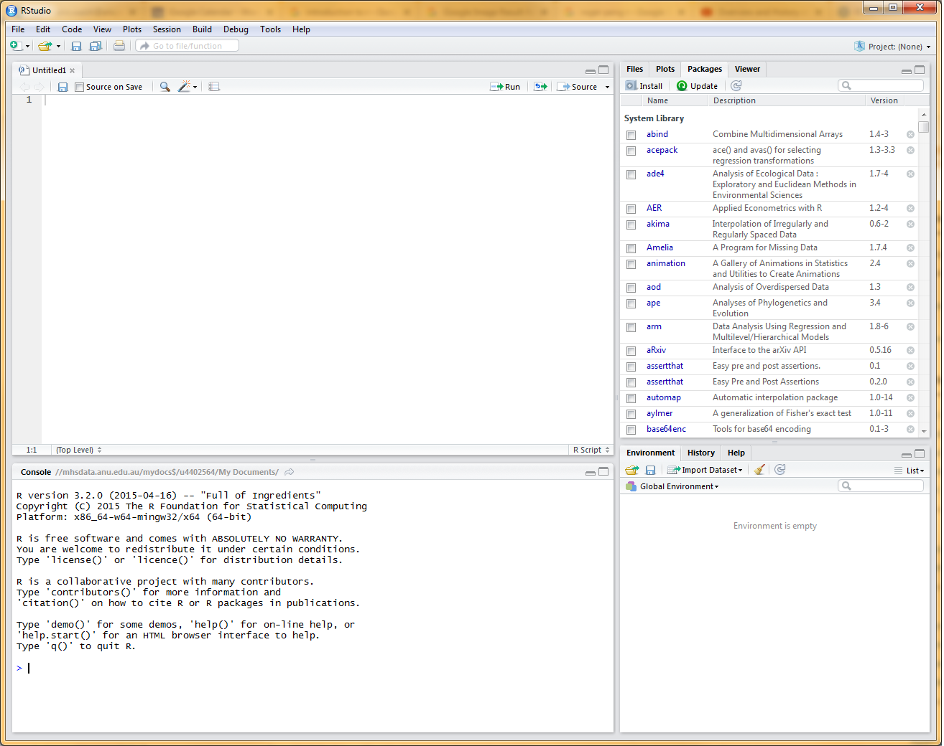
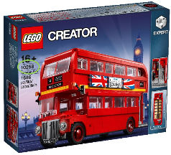
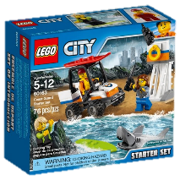

Slide 10
Basic R orientation
Won’t walk through a single analysis: this is about building your vocabulary, and what makes R special.
Exercise time!
Working in the console and script window in Rstudio
Value/variable assignment and the environment

Slide 11
Functions
Variable assignment: give a number a name
Function: takes input, does something, returns output
function_name <- function(input1, input2, ... ){ statements return(output) }
Exceptionally powerful for
Simplifying code
Reproducable science
Same result each time
If you discover an arithmetic mistake, single update to fix
Exercise time!

Slide 12
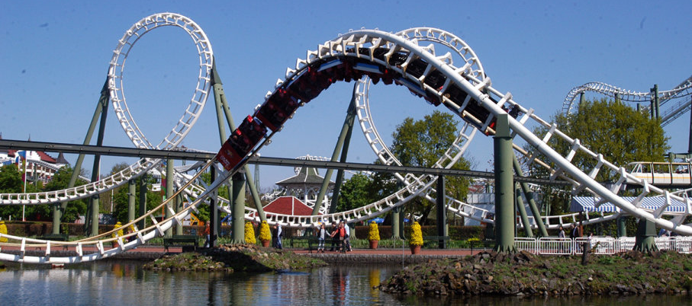
Loops
a sequence of instructions that is continually repeated until a certain condition is reached.
Common example is a ‘for’ loop: repeats an operation a specified number of times
for(iteration in number of times) {do something}
Extremely useful in combination with a function
Exercise time!
Image from: https://r.hswstatic.com/

Slide 13

Packages
A collection of functions someone else has written
Install once
Import each time
Exercise time!

Slide 14
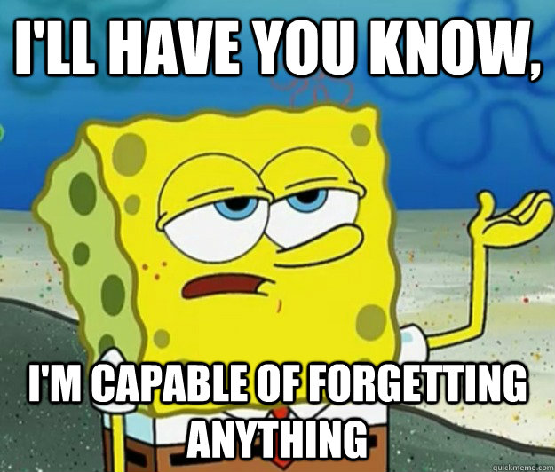
Scripts
Save your functions and code for next time
Organise and annotate as you code
Run in one go, or step-by-step
Set aside important functions so you don’t edit them by mistake
Exercise time!

Slide 15

Importing and working with data
Very similar to importing scripts
Never edits the source data file, just keeps a copy in R
Data: temperature and humidity in my house from 10:25 PM 15/1/2019 to 8:02 AM 16/1/2019, 116 sampling occasions (this is what happens when scientists live together)
Exercise time!

Slide 16
R Markdown
Icing on the cake
A file format for making dynamic documents
Like a script, but does more: Contains chunks of embedded R code alongside neatly formatted text.
Makes the WHOLE process reproducible and flexible. Without cutting and pasting a single coefficient into a single table, any point you can
Update the dataset
Update the analysis (including functions/loops)
Update the look/feel of the output
Exercise time!

Slide 17
Conclusion
R is free software that is a unique combination of command line and programming approaches, with a nice RStudio GUI on top.
It is ideal for truly reproducible science
The capacity to build your own functions and use the massive package library makes it extremely extensible
The ideas we covered today (functions, loops, packages, scripts and markdown) are not unique to R, but their seamless combination is its great strength
There’s R users everywhere, and we want to help you learn how to make the most of it!

